Slide 1

Gas Machinery Conference
2012 Short Course
Suggested Methodologies
for Unloading
Reciprocating Compressors
Joe Fernandez
Ariel Corporation
Kelly Eberle
Beta Machinery
Dwayne A. Hickman
ACI Services, Inc.

Slide 2
Disclaimer!
Today’s presenters are
discussing topics
from the viewpoint
of the industry in general.
Guidelines and rules expressed today
do not necessarily reflect
the actual guidelines and rules
of the company for which they work.
DH

Slide 3
Unloading Methodologies Short Course
Provide course attendees with:
  A fundamental review of common unloading
  devices for reciprocating compressors,
  Guidelines for developing, evaluating and
  implementing unloading sequences,
  Solid understanding of concerns, issues,
  and consequential problems if load steps
  are not properly reviewed,
DH

Slide 4
Unloading Methodologies Short Course
What is an Unloading Sequence?
  Specific Arrangement of Unit Unloading Devices
    Each Device Useable while Unit is Running
    Each Device Affects Load and/or Flow
    Each Device has a Discrete Change
  Common Devices are:
    Clearance Pockets
    End Deactivators
DH

Slide 5
Unloading Methodologies Short Course
Alternates to Unloading Sequences
  Devices Used to Fill-in between Discrete Load Steps
    Speed Control
    Hydraulic, Electric or Pneumatic Variable
  Volume Clearance Pockets
  Devices Used as a Stand-alone System
    Timed Suction Valve Unloaders
      Ex. HydroCOM
      Ex. Infinite Step
These Types of Devices will Not
be Covered in this Short Course
DH

Slide 6

Unloading Methodologies Short Course
Why use Load Steps?
  Reduce Load for Easier Startup
  Gradual Loading After Startup
  Avoid Driver Overload as Conditions Change
  Deliver Required Flow Rate
  Maximize Driver Load Utilization and Flow
  Handle System Upsets without Shut Downs
  Accommodate Wide Range of Conditions
  System Optimization
DH

Slide 7
Unloading Methodologies Short Course
What Parameters Significantly
Affect Load and Flow?
  Suction and Discharge Pressures
  Suction Temperatures
  Gas Properties
  Speed
  Cylinder Clearances
  Number of Cylinder Ends Deactivated
DH

Slide 8
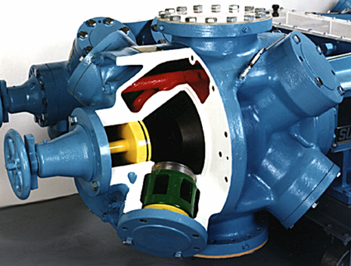
Quick Review:
Unloading
Device
Types
JF

Slide 9
Variable Speed Control
Quick Review: Devices
Variable Speed Control
End Deactivation
Added Variable Volume Clearance
Added Fixed Volume Clearance Devices
Defined
  Adjustment of the prime mover operating speed
  Control system evaluates a process variable and adjusts speed
  Affects the suction and discharge events
  Same adiabatic load per revolution, just a change in RPM
Devices
  Governor
  Fuel Control Valve
  Variable Frequency Drives
  Torque Controllers
✓
JF

Slide 10

Variable Speed Control
Governors, VFD & Other Speed Control
What is it?
  Fuel Control Valve; Mechanical Governor; Torque Controller; Variable Frequency Drive
What does the device do?
  Decreases / Increases the prime mover operating speed
Where is it installed?
  Designed as part of the prime mover control system
Image courtesy of GE Waukesha Engine Division
JF

Slide 11
End Deactivation
Quick Review: Devices
Variable Speed Control
End Deactivation
Added Variable Volume Clearance
Added Fixed Volume Clearance Devices
Defined
  Means to allow gas to flow out of the cylinder end during the compression stroke
Devices
  Internal Body Ports
  Suction Valve Unloaders (Finger and Plug-type)
  Radial Valve Unloaders
  Valve Assembly Lifter
  Front Head Plug-type Bypass
✓
JF

Slide 12
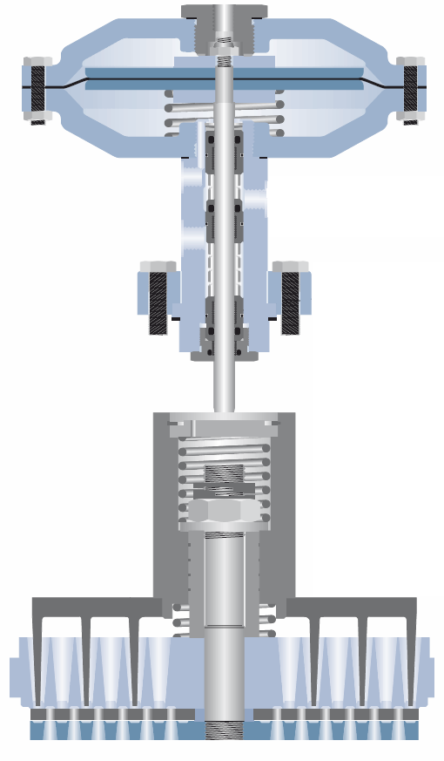
End Deactivation
Finger-type Valve Unloaders
What is it?
  Plunger with fingers attached
  Fits into the seat of the valve
What does the device do?
  Depresses the valve plates (deactivating the cylinder end)
  Allows gas to pass through the valves during the compression event
  Gas passes back onto the inlet passage
Where is it installed?
  Over suction valves (head or crank end)
Image Courtesy of Hoerbiger Corp.
JF

Slide 13
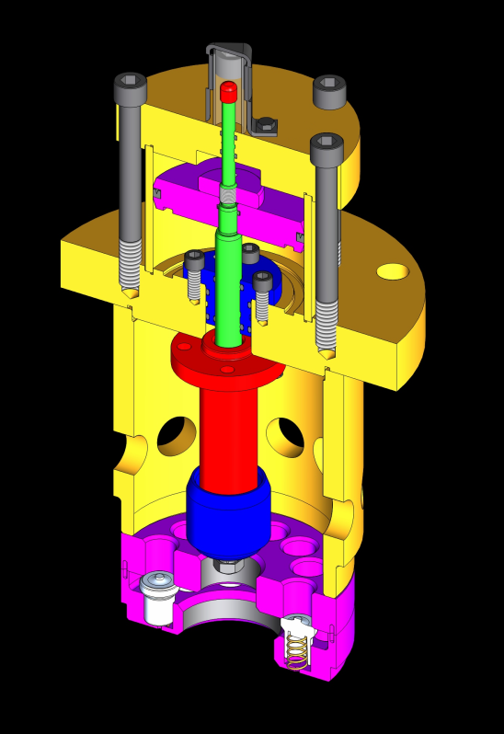
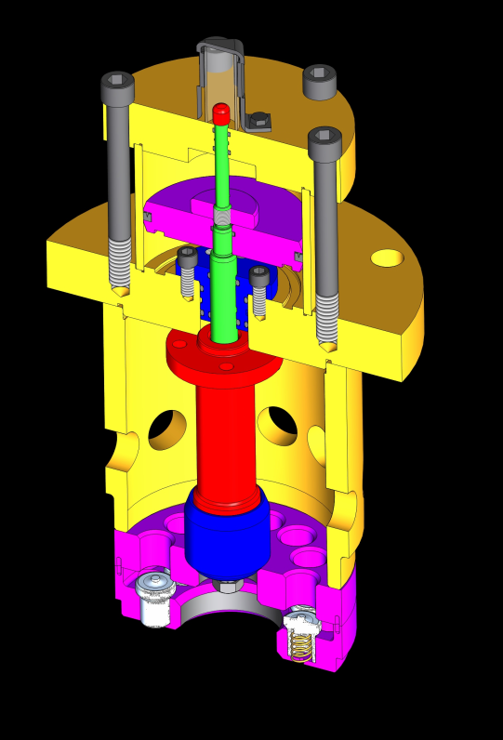
End Deactivation
Plug-type Valve Unloaders
What is it?
  Shaft with a plug attached
  Partial valve with a hole in the center
What does the device do?
  Deactivates the cylinder end
  Allows gas to pass through the hole in the valve during the compression event
  Gas passes back into the inlet passage
Where is it installed?
  Over suction valves (head or crank end)
OPEN
Gas flows
around valves
CLOSED
Gas flows
through valves
Images Courtesy of ACI Services, Inc.
JF

Slide 14
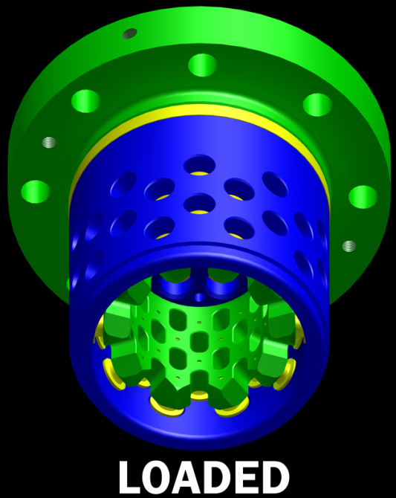
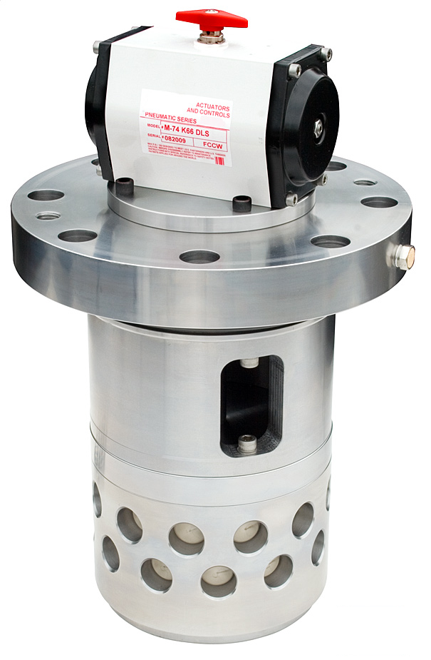
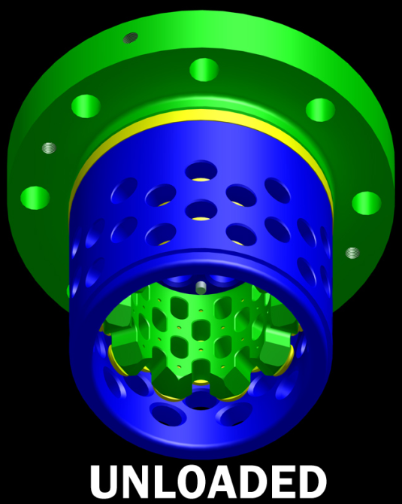
End Deactivation
Radial Poppet Unloaders
What is it?
  Poppet valve assembly
  Guard which holds the poppets connected to an actuator assembly
  Cylindrical seat for poppets
What does the device do?
  Deactivates the cylinder end
  Allows gas to flow through seat
  Gas flows back into inlet passage
Where is it installed?
  Suction valves (head end or crank end)
Images Courtesy of ACI Services, Inc.
JF

Slide 15
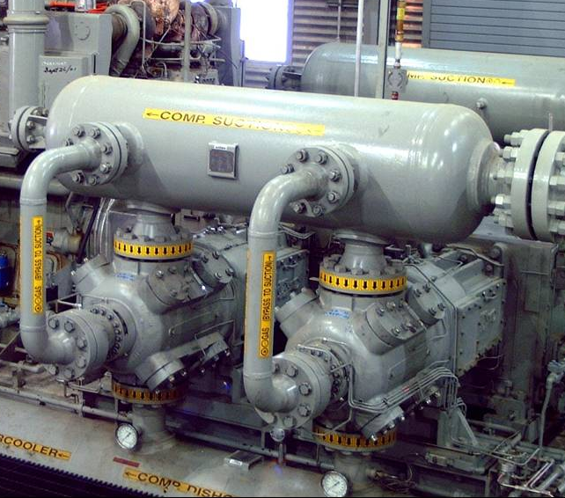
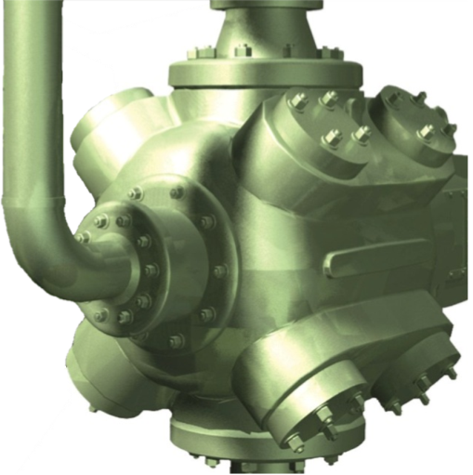
End Deactivation
Front Head Plug-type Bypass
What is it?
  Front end head with a bypass plug and actuator assembly
  External piping to inlet passageways
What does the device do?
  Deactivates the cylinder end
  Allows gas to flow through the bypass plug to the bottle or suction valve
Where is it installed?
  Cylinder Head End Head
Images Courtesy of ACI Services, Inc.
JF

Slide 16
Variable Volume Clearance
Quick Review: Devices
Variable Speed Control
End Deactivation
Added Variable Volume Clearance
Added Fixed Volume Clearance Devices
Defined
  Adjust clearance volumes within the design of the device
  Accomplished by Manual, Hydraulic, or Gas Forces
Devices
  VVP – Manual Screw Type
  VVP – Power Screw Type
  VVP – Hydraulic Assisted
  VVP – Gas Pressure Controlled
✓
JF

Slide 17
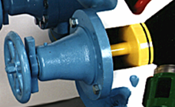
Variable Volume Clearance
VVP (Manual Screw Type)
What is it?
  Variable clearance device
  Design as the head end head
  Piston installed on a lead screw
What does the device do?
  Moves the piston away from cylinder bore
  Adds fixed clearance to the cylinder end
  Fixed clearance is changed in increments
Where is it installed?
  Cylinder head end head
Image Courtesy of Cameron Corporation
JF

Slide 18
Added Fixed Volume Clearance
Quick Review: Devices
Variable Speed Control
End Deactivation
Added Variable Volume Clearance
Added Fixed Volume Clearance Devices
Defined
  Adjust clearance volumes within the design of the device
  Accomplished by Manual, Hydraulic, or Pneumatic Forces
Devices
  Front Head Volume Pocket
  Valve Cap Volume Pocket
  Internal Body Volume Pocket
✓
JF

Slide 19
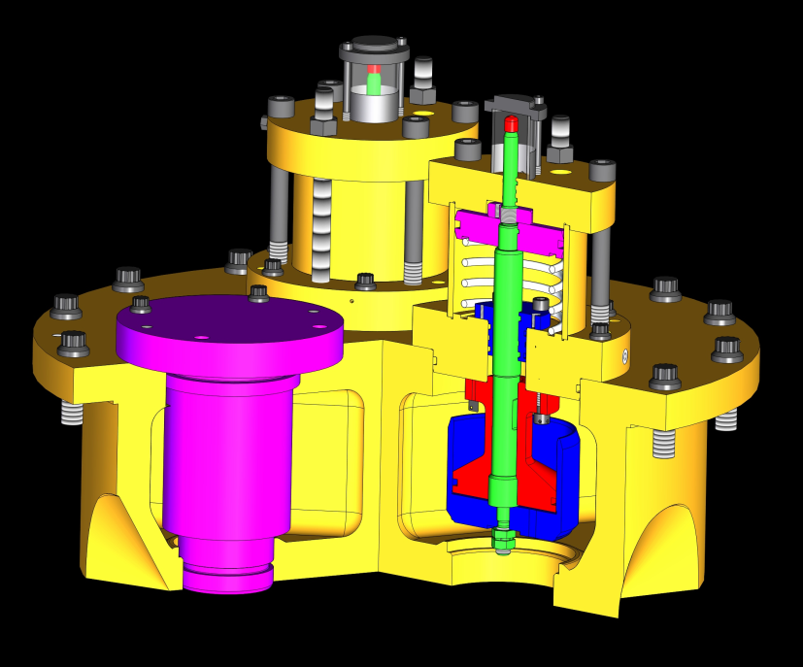
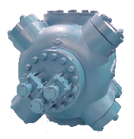
Added Fixed Volume Clearance
Front Head Volume Pockets
What is it?
  Fixed clearance device
  Designed for the front head
  Actuator assembly
What does the device do?
  Adds a predetermined amount of fixed clearance to the cylinder end
Where is it installed?
  Cylinder head end head
Photo Courtesy of ACI Services, Inc.
Photo Courtesy of Ariel Corporation
JF

Slide 20
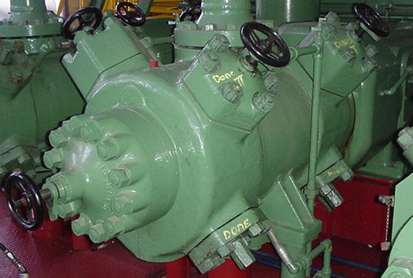
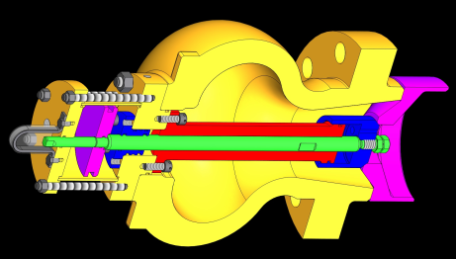
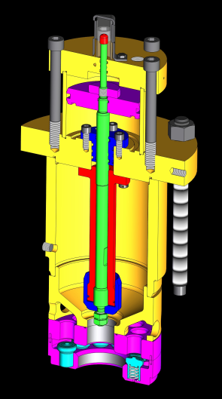
Added Fixed Volume Clearance
Valve Cap Volume Pocket
What is it?
  Fixed clearance device
  Designed as part of the valve cap
  Actuator assembly
What does the device do?
  Adds a predetermined amount of fixed clearance to the cylinder end
Where is it installed?
  Over a suction or discharge valve on the head or crank end of the cylinder
Photo Courtesy of Dominion Resources
Images Courtesy of ACI Services, Inc.
JF

Slide 21
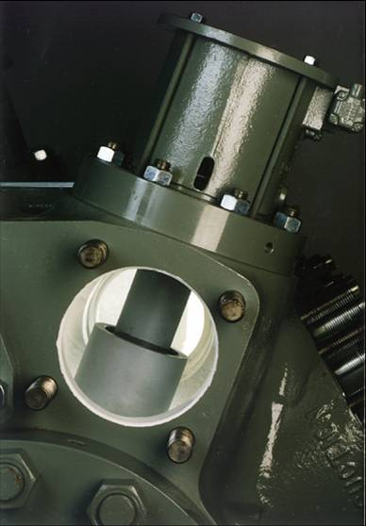
Added Fixed Volume Clearance
Internal Body Volume Pockets
What is it?
  Fixed clearance device
  Actuator assembly
What does the device do?
  Adds a predetermined amount of fixed clearance to the cylinder end
Where is it installed?
  Cavity casted into the cylinder
  Head end or crank end
Photo Courtesy of Cameron Corporation
JF

Slide 22
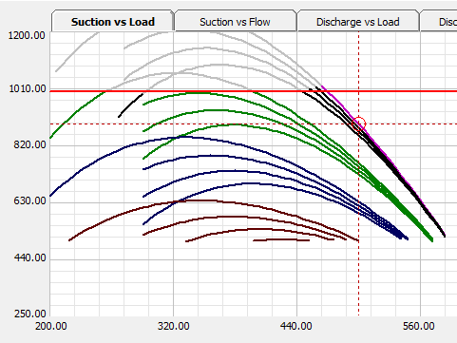
Quick Review:
Load
Steps
DH

Slide 23
Quick Review: Load Steps
  Typical Load Step Sequence:
  Full Load
  Open Both VVCPs 5% (0.5-in)
  Open Both VVCPs 10% (1.0-in)
  Open Both VVCPs 15% (1.5-in)
  Open Both VVCPs 20% (2.0-in)
  Open Both VVCPs 25% (2.5-in)
  Open Both VVCPs 30% (3.0-in)
  Open Both VVCPs 35% (3.5-in)
  Open Both VVCPs 40% (4.0-in)
  Open Both VVCPs 45% (4.5-in)
  Open Both VVCPs 50% (5.0-in)
  Or:
  Full Load
  Open HE#1 Pocket
  Open HE#1/#3 Pockets
  Open HE#1/#3/#5 Pockets
  Deact HE#1
  Deact HE#1 & Open HE#3 Pckt
  Deact HE#1 & Open HE#3/#5 Pckts
  Deact HEs#1/#3
  Deact HEs#1/#3 & Open HE#5 Pckt
  Deact HEs#1/#3/#5
DH

Slide 24
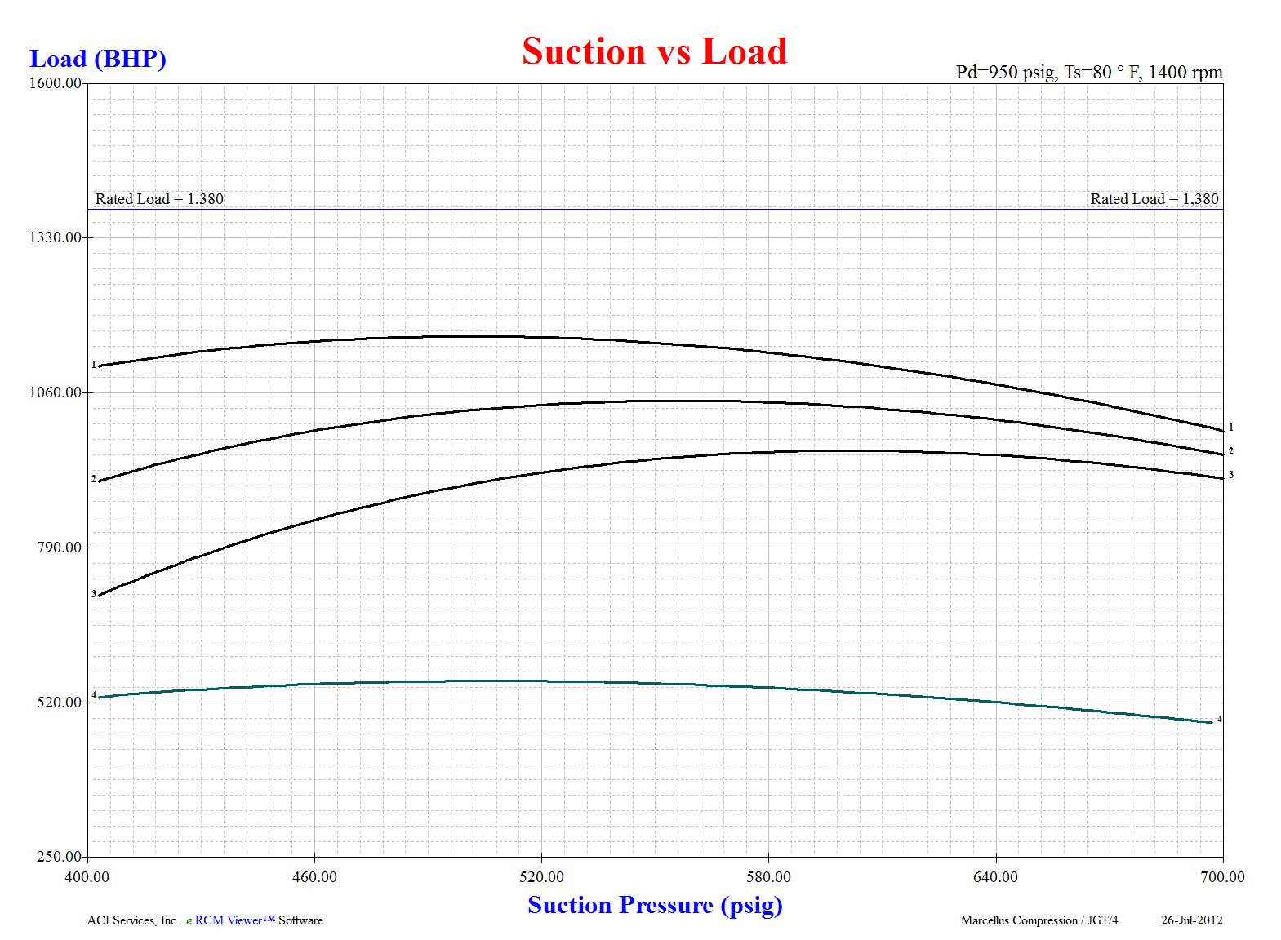
Quick Review: Load Steps
LOAD
All Devices Closed
Open One Pocket
Open Two Pockets
Deactivate One End
PRESSURE
DH

Slide 25

Quick Review: Load Steps
  As pressures and temperatures change, unit may overload.
  Having other available safe load steps allows the unit to be unloaded so that it can continue to safely operate.
  Speed is a good flow control device, but not a good load control device.
DH

Slide 26

Quick Review:
Unloading
Sequence
Objectives
DH

Slide 27
Quick Review: Unloading Sequences
General Objectives:
Safely unload unit via reasonable changes in load to prevent overloading of driver, and
Safely unload unit via reasonable changes in flow to achieve desired flow rates, maintain desired pressures, or prevent high temperatures.
DH

Slide 28
Quick Review: Unloading Sequences
Common Objectives:
Create Load Steps of Appropriate Load Changes
  Approximately ±5% apart for Variable-speed Units
  Approximately ±3% apart for Fixed-speed Units
Load Steps should Cover Widest Operating Map
Primary Preference for Clearance-based Devices:
  Not Always Ideal for Low Ratio Applications
  Apply Caution with High Ratio Applications
Secondary Preference for End Deactivators:
  Can lead to higher Pulsation & Torsional Concerns
  Can lead to Rod Load & Pin Reversal Concerns
  Can increase Parasitic Losses
DH

Slide 29
Quick Review: Unloading Sequences
Common Objectives:
Balance Forces & Pressures:
  On a per Stage Basis:
    Discharge Temperatures,
    Compression Ratios,
  On a per Throw Basis:
    Cylinder Head End vs. Crank End,
  Across Opposing Throws,
Keep Torque Effort as Smooth as Possible,
Minimize both Valve Losses and Parasitic Losses.
DH

Slide 30
Quick Review: Unloading Sequences
Unit Unloading Abilities:
Turndown from 100% to 90%
  High Volume Units
  Some Tightly-controlled Process Units
Turndown from 100% to 75%
  Most Common Amount of Turndown
  Typical with Natural Gas Units
DH

Slide 31
Quick Review: Unloading Sequences
Unit Unloading Abilities:
Turndown from 100% to 50%
  Wide Map Coverage Units
  Some Process Units
  Some Injection/Withdrawal Units
Turndown from 100% to 25%, or even 0%
  Flow Control is Primary Objective
  Process Units
  Usually over a Limited Operating Map
DH

Slide 32
Quick Review: Unloading Sequences
For Integral Frames:
  Sequence of Clearance unloading devices engaged based on throw locations is typically not relevant for torsional.
    Not usually relevant for pulsations either unless very large clearance changes are made.
  Sequence of End Deactivation unloading devices engaged based on throw locations is typically not relevant for torsional.
    Still very relevant to pulsations.
DH

Slide 33
Quick Review: Unloading Sequences
For Separable Frames:
  Sequence of Clearance unloading devices engaged based on throw locations is usually not relevant to torsional.
    Exceptions can happen: If too much clearance is used (Low Vol. Eff.), then this becomes more similar to End Deactivation.
  Sequence of End Deactivation unloading devices engaged based on throw locations is typically VERY relevant to torsional.
    Ultimately depends on throw offset angles of crank used. Consult OEM for best options.
DH

Slide 34
Quick Review: Unloading Sequences
For Both Types of Frames:
  Only under ideal situations and with OEM approval should crank ends be deactivated while still compressing on head ends (SAHE).
  Unload head ends before unloading crank ends to avoid pin non-reversal issues.
  Unloading 1st stage is usually the best bang for the buck.
  Unloading 2nd stage is very often useful.
      Option A: Unload both stages appropriately together to maintain more balanced interstage pressures, and avoid curve-crossing.
      Option B: Unload first stage complete (or as much as useful), then simultaneously reload part of the 1st stage unload the 2nd stage, then continue to unload the 1st stage. This option usually gives more load steps and hence better operating map coverage.
  Unloading of 3rd and higher stages is rare. Often can lead to rod load and pressure issues.
DH

Slide 35
Quick Review: Unloading Sequences
For Both Types of Frames:
  Balancing unloading across the cylinder may be important.
      Avoid too much added clearance to one end (especially crank end).
  Balancing of load across all cylinder in that stage is important.
  Balancing of load across opposed throws is usually not that important.
    When it is, torsional report will indicate this.
  Deactivation of either end of a tandem cylinder is usually not a good thing to do.
    Always consult OEM.
  Review load steps across full range of pressures, temperatures and speeds.
    Many times, load steps that look good at lower discharge pressures become unusable at higher pressures.
    Many times, load steps that look good at rated speeds break apart due to rod loads and/or pin non-reversal issues at lower speeds.
DH

Slide 36
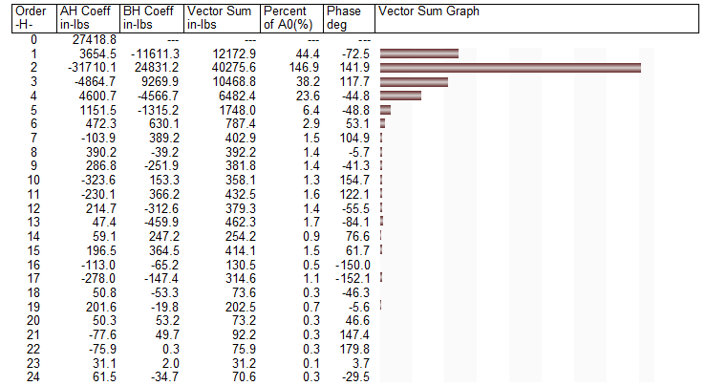
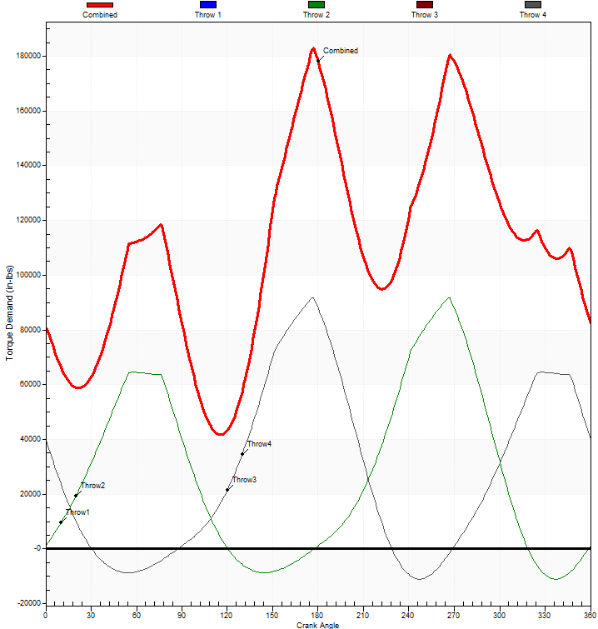
Quick Review:
Torque
Effort &
Harmonics
KE

Slide 37
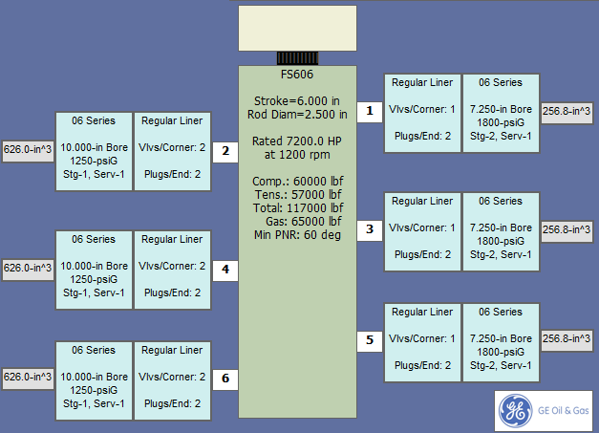
Quick Review: Torque Effort & Harmonics
Stage-1
Stage-2
KE

Slide 38
Quick Review: Torque Effort & Harmonics
Typical Goals are to Adjust Unloading to:
Minimize Torque Fluctuations
Equalize Torque Fluctuations on Throws
Avoid High Torque Fluctuations Near Drive or Aux End
Minimize Number of Harmonic Orders with High Torque Fluctuations
KE

Slide 39
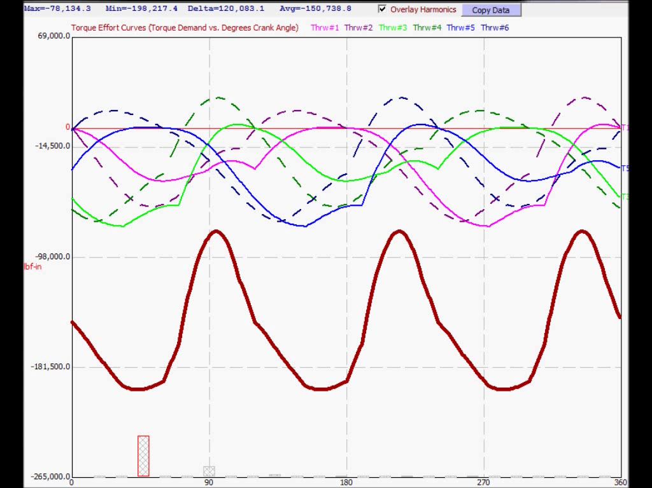
Quick Review: Torque Effort & Harmonics
All DA
All DA
Add 2nd Stg Clearance
Add 1st Stg Clearance
Dynamic Torque Increases more than 3x from DA to SA
Deactivate 1st Stage HEs
Deactivate 2nd Stage HEs
KE

Slide 40
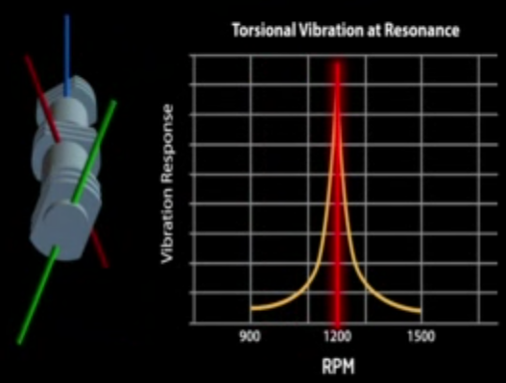
Quick Review:
Torsional
Concerns
JF

Slide 41
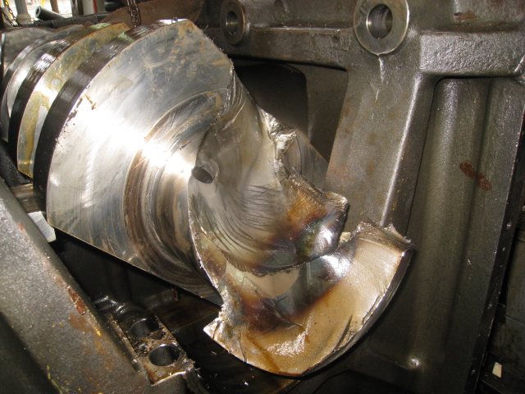
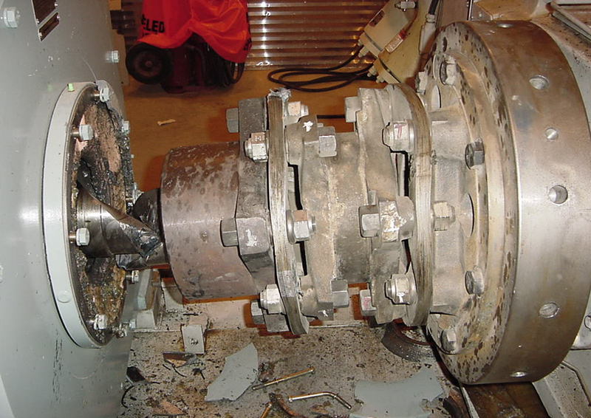
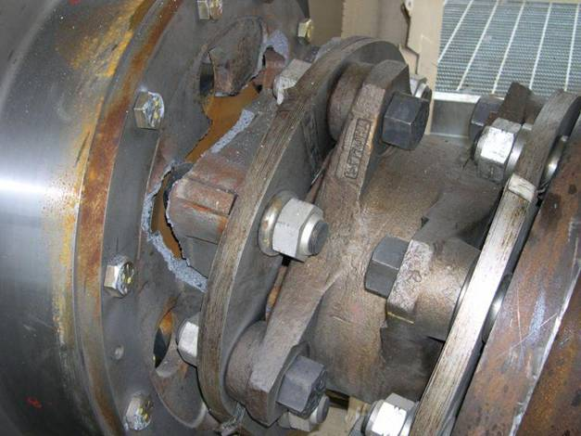
Quick Review: Torsional
Why Do we need a Torsional Analysis?
To Prevent
Motor failures
Crankshaft failures
And Other Nasty Problems
Coupling Failures
JF

Slide 42
Quick Review: Torsional
When is a Torsional Vibration Analysis needed?
New Driver-Compressor Combination
Changes in Compressor Configuration
  Such as Restaging, New Cylinders, or Liners
Different Motor
Changes in Original Operating Conditions
For Drive Trains Experiencing Failures
VFD Applications
Major Changes in Cylinder Unloading
JF

Slide 43
Quick Review: Torsional
What information is needed?
  Complete Description (Layout) of System
  Dimensional Shaft Drawings
  WR2 & Stiffness of Driveline Components (Mass Elastic)
  Shaft Material Properties
  Details of Areas with High Stress Concentration Factors
  Coupling Drawing with Torque Rating
  Operating Conditions (Selected Load Cases)
  Forcing Functions (Fourier Expansion Coefficients)
JF
Notes:
Equivelent rotating masses and springs modeled based on geometires and material properties.

Slide 44
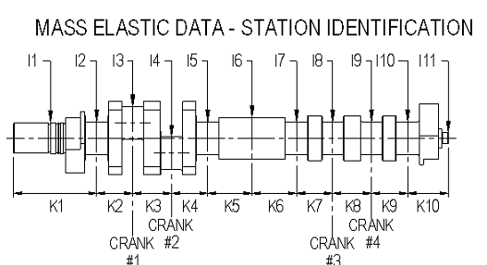
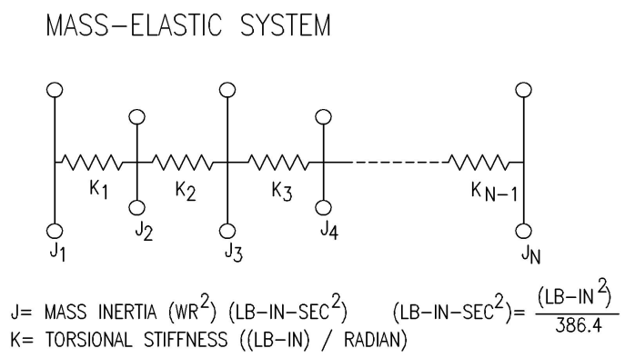
Quick Review: Torsional
What information is needed?
Mass Elastic Data
Typical 4 Throw Compressor Torsional Input “Station” Layout
Compressor Crank Modeled as Equivalent Rotating Masses and Springs
JF
Notes:
Equivelent rotating masses and springs modeled based on geometires and material properties.

Slide 45
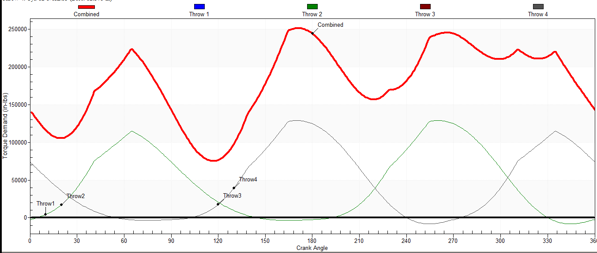
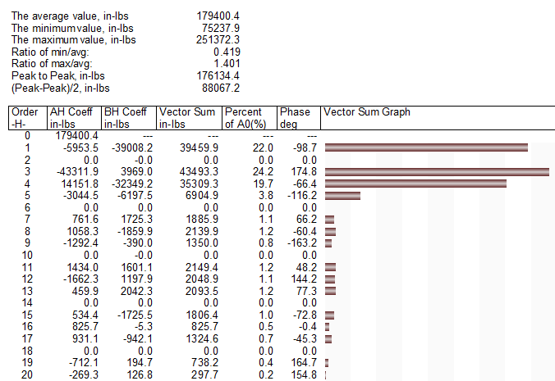
Quick Review: Torsional
What information is needed?
Identify Worst Unloading Steps from a Torsional Perspective
  Critical and Challenging
Process Aided by Reviewing Combined Crankshaft Torque Demand Curves (and Review of Fourier Expansion Coefficients)
JF
Notes:
Equivelent rotating masses and springs modeled based on geometires and material properties.

Slide 46
Quick Review: Torsional
So, what is the best unloading scheme?
  There is NO absolute statement that can be made for the best unloading sequence.
  Each application is distinctive and must be reviewed.
  All practical unloading sequences must be included to identify most torsional friendly approach
However, odds are pretty good that whatever unloading approach is the best from a torsional standpoint, it will create problems for the Acoustical Study provider.
JF

Slide 47

Quick Review:
Pulsation &
Vibration
Concerns
KE

Slide 48
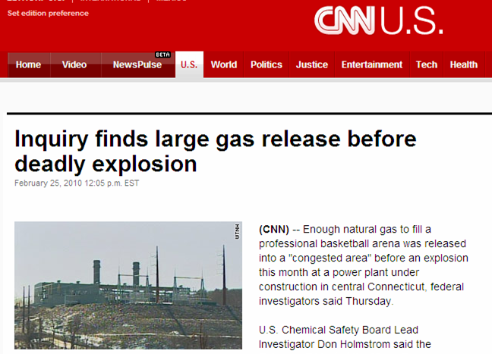
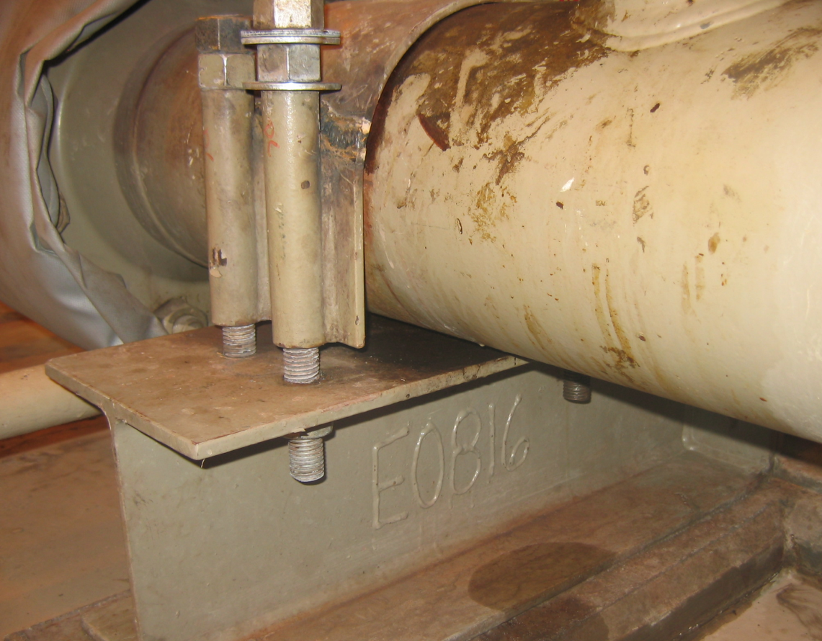
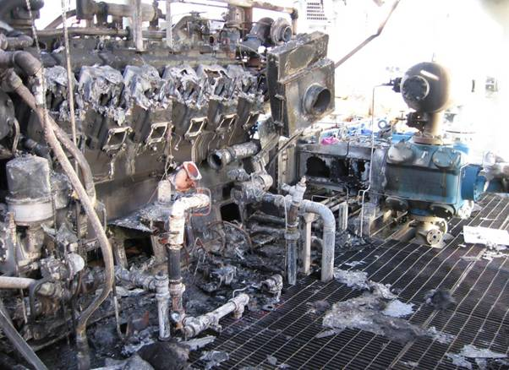
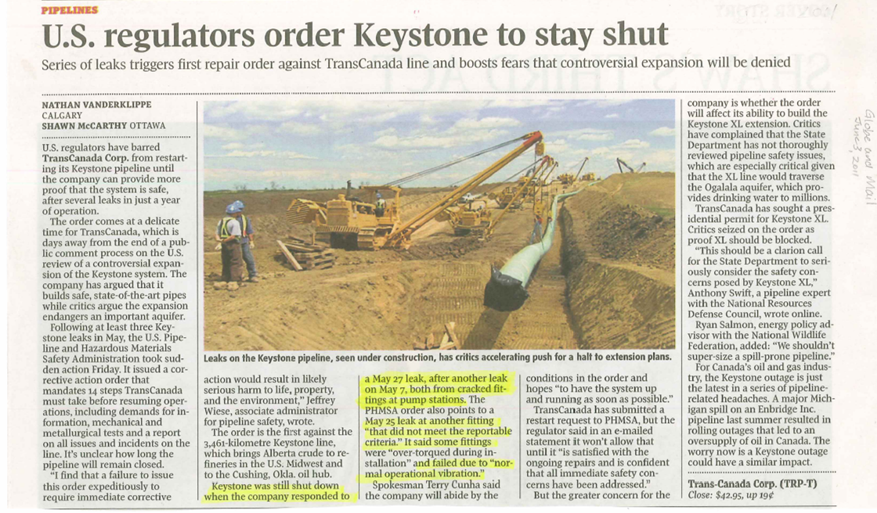
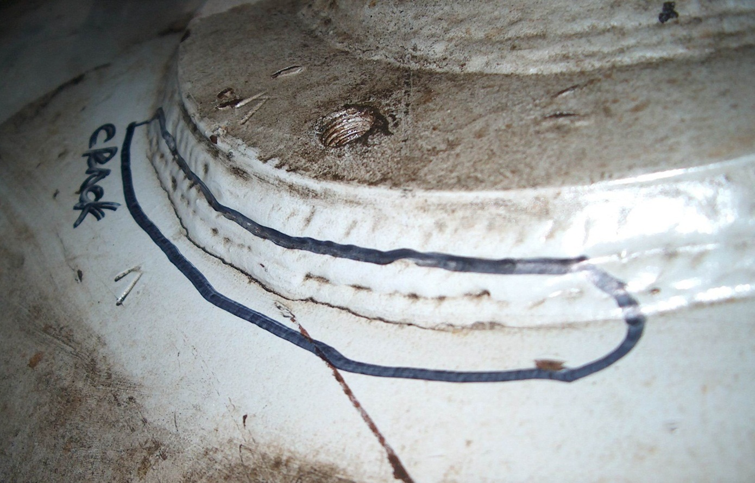
Quick Review: Pulsation & Vibration
Fatigue Failures are Problems on Packages
PIPELINE
company
pipeline
company
pipeline
company
pipeline
company
Goal: Design Machines
that are Safe, Reliable, and
Available for Operations
PL
pipeline
company
line
pipe-
pipeline
company
company
pipeline
company
company
pipeline
pipeline
pipeline
company
company
KE
Notes:
Fatigue failures can lead to small problems like broken clamps to big problems.
What is an acoustic review, what does it identify, and why is it required? Pulsations & Vibrations
Avoid discussing HOW it is done, but rather on why, results of review, and what information is required to do one.
Also, what unit changes after unit is installed would prompt for a new acoustic review?

Slide 49
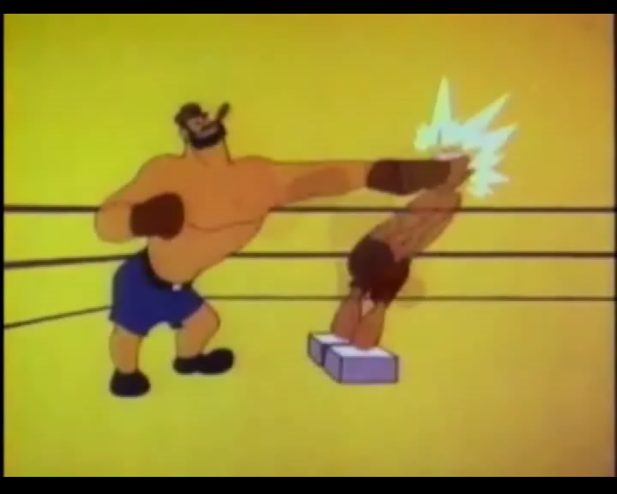
Quick Review: Pulsation & Vibration
Main goal of Pulsation and Vibration is to avoid fatigue failures by controlling vibration, How?
Vibration =
Dynamic Force
X
Dynamic Flexibility
KE

Slide 50
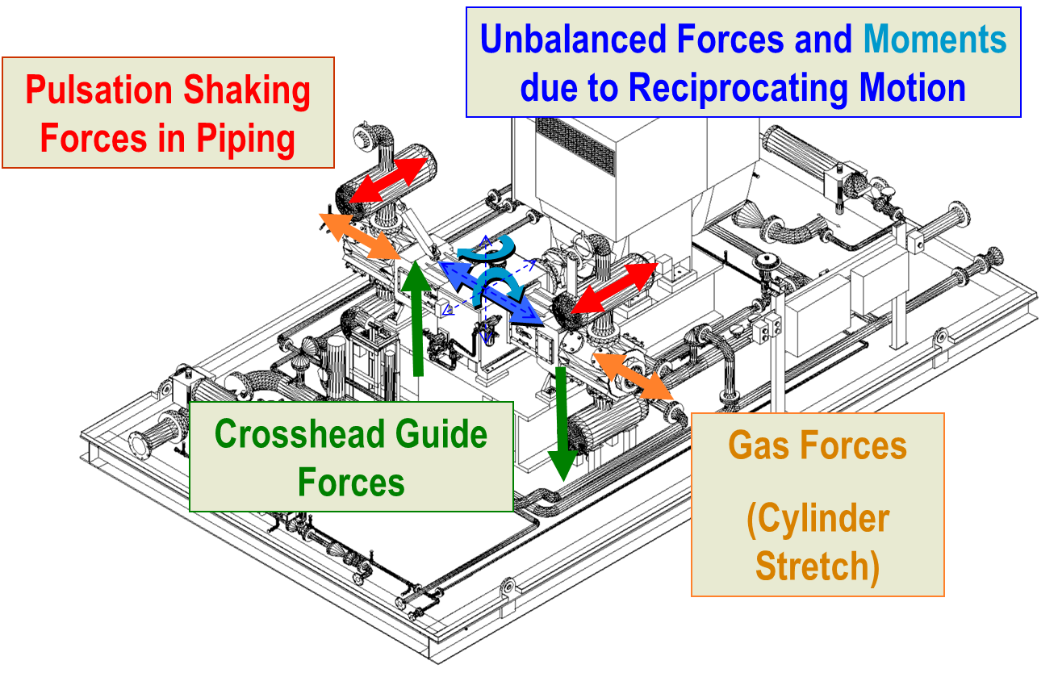
Quick Review: Pulsation & Vibration

Slide 51
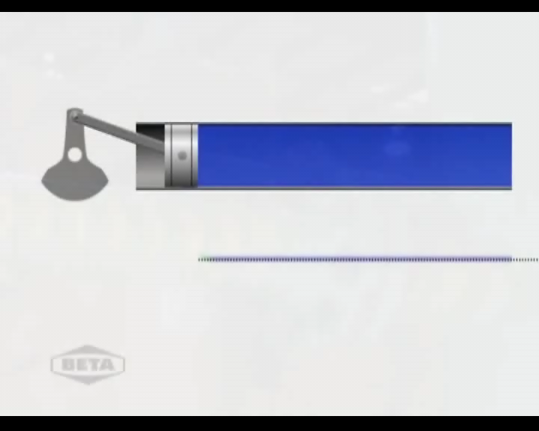
Quick Review: Pulsation & Vibration
Only Pulsations can be Controlled
KE

Slide 52
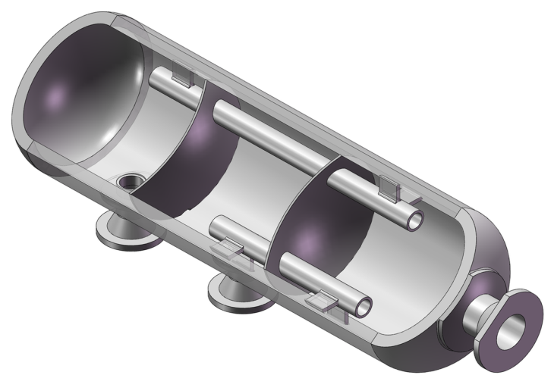
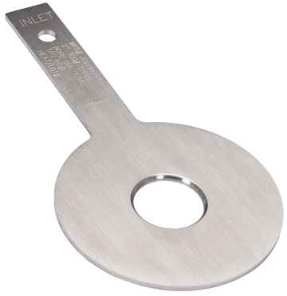
Quick Review: Pulsation & Vibration
How are Pulsation Forces Reduced?
Bottle Design
Orifice Plates
Pipe Layout
KE

Slide 53
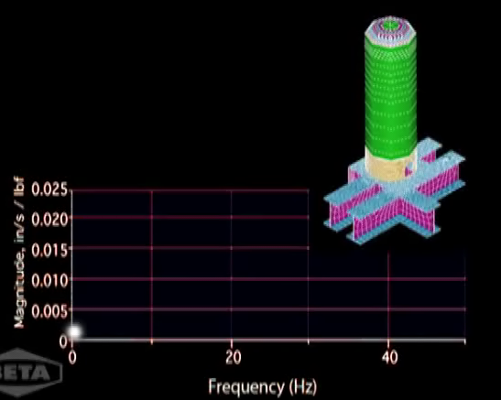
Quick Review: Pulsation & Vibration
How to Reduced Dynamic Flexibility?
Increase Static Stiffness
Reduce Mass
Flexibility is very High at the
Mechanical Natural Frequency
(MNF)
KE
Notes:
First arrow delay is 0.6s. Second arrow delay is 1.2s.

Slide 54
Quick Review: Pulsation & Vibration
How to reduce Dynamic Flexibility?
Short, Large Diameter Scrubbers
Bigger Skid Beams
Smaller Bottles
More Supports
Bracing
Stiffer, Lighter, Lower
KE

Slide 55
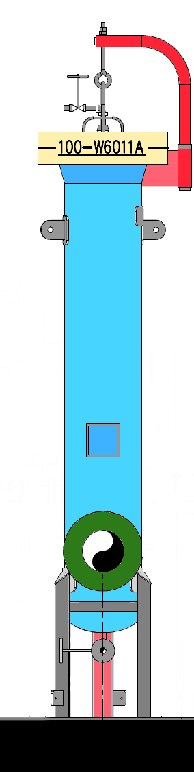
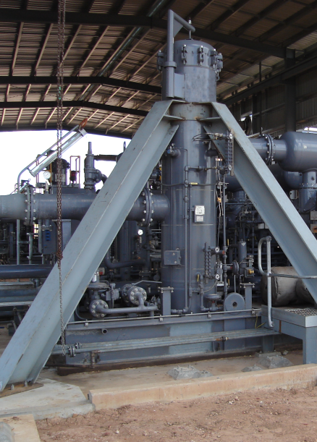
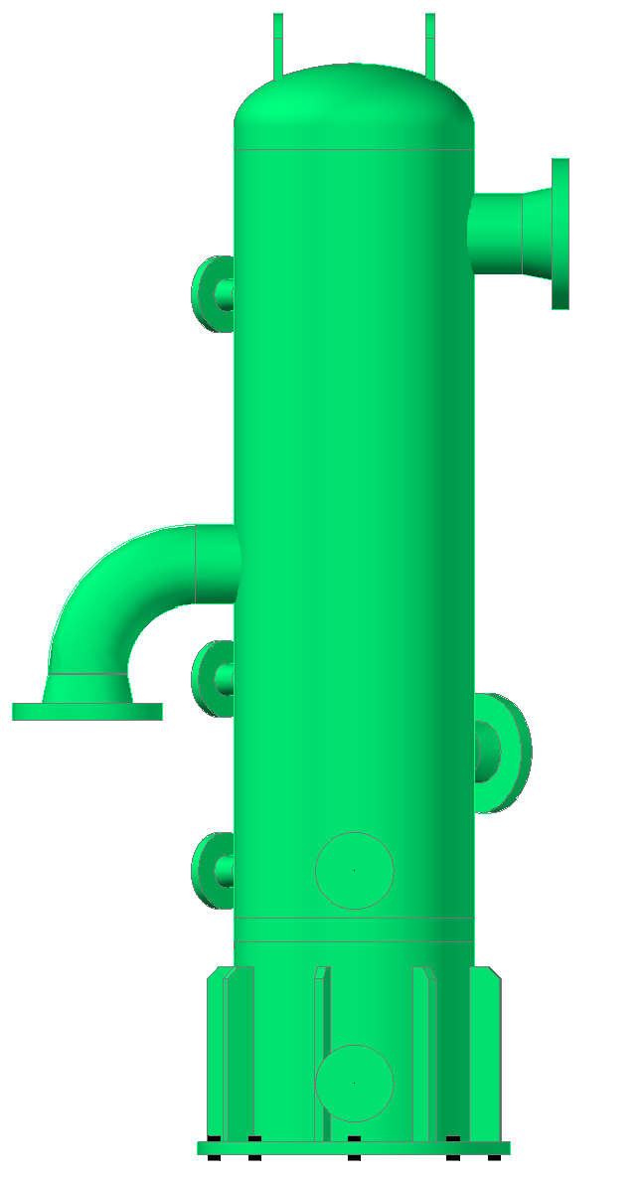
Quick Review: Pulsation & Vibration
Good
Bad
Ugly
KE

Slide 56

Quick Review: Pulsation & Vibration
Summary
Vibration =Dynamic Force X Dynamic Flexibility
Dynamic Force
4 Main Sources
Pulsations only one that can be controlled
Dynamic Flexibility
Increase Stiffness
Reduce Mass
KE

Slide 57
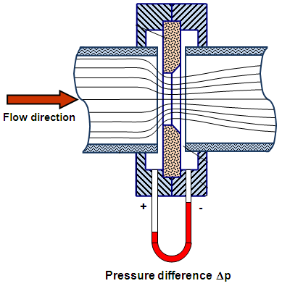
Quick Review:
Pressure
Drop
Concerns
KE

Slide 58
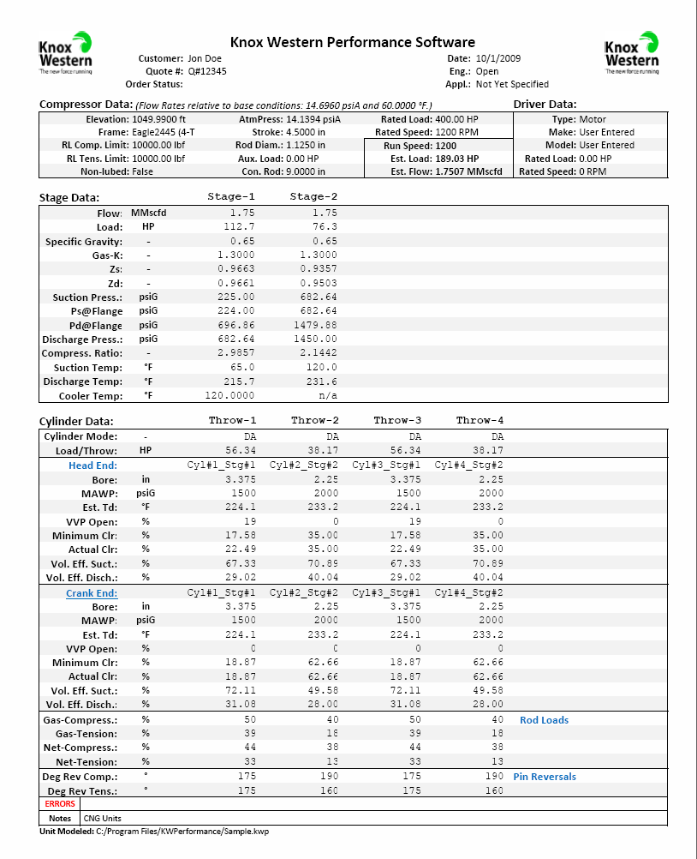
Quick Review: Pressure Drops
Why is Pressure Drop Important?
INPUT
OUTPUT
Compressor Geometry
Capacity
Gas Properties
Required Power
Inlet and Outlet Pressure
Interstage Pressure and Temperatures
Inlet and Outlet Temperature
Rod Load
Pressure Drop
Load Step
KE
Notes:
What are pressure drops and what causes them?
Static/Dynamic Drops
Choke Tubes/Bottles/Orifice Plates
Fence-to-Fence, Flange-to-Flange
Avoid discussing method for modeling them, but rather on why they are important, results of a review, and what information is required to estimate drops.
Also, identify what unit changes after unit is installed that might affect pressure drops?

Slide 59
Quick Review: Pressure Drop
What is Checked in a Pulsation Design?
Static Pressure Drop in Pulsation Control Devices (API 618)
What about Total Pressure Drop?
  What is that?
What about other System Components?
KE

Slide 60
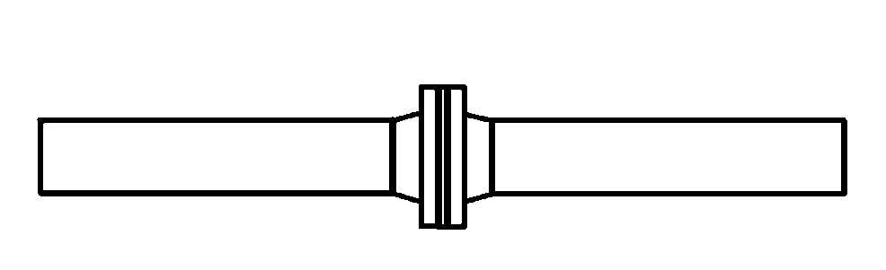
Quick Review: Pressure Drops
Static Pressure Drop
P1
P2
Flow
Flow Velocity
Pressure Drop
Time
Time
KE
Notes:
What are pressure drops and what causes them?
Static/Dynamic Drops
Choke Tubes/Bottles/Orifice Plates
Fence-to-Fence, Flange-to-Flange
Avoid discussing method for modeling them, but rather on why they are important, results of a review, and what information is required to estimate drops.
Also, identify what unit changes after unit is installed that might affect pressure drops?

Slide 61
Quick Review: Pressure Drop
Total Pressure Drop
P1
P2
Flow
Instantaneous Flow
Instantaneous Pressure Drop
Flow Velocity
Pressure Drop
Total (Mean) Pressure Drop
Time
Time
KE
Notes:
What are pressure drops and what causes them?
Static/Dynamic Drops
Choke Tubes/Bottles/Orifice Plates
Fence-to-Fence, Flange-to-Flange
Avoid discussing method for modeling them, but rather on why they are important, results of a review, and what information is required to estimate drops.
Also, identify what unit changes after unit is installed that might affect pressure drops?

Slide 62
Quick Review: Pressure Drops
Dynamic Pressure Drop
Total Pressure Drop
Pressure Drop
Static Pressure Drop
Time
KE
Notes:
What are pressure drops and what causes them?
Static/Dynamic Drops
Choke Tubes/Bottles/Orifice Plates
Fence-to-Fence, Flange-to-Flange
Avoid discussing method for modeling them, but rather on why they are important, results of a review, and what information is required to estimate drops.
Also, identify what unit changes after unit is installed that might affect pressure drops?

Slide 63
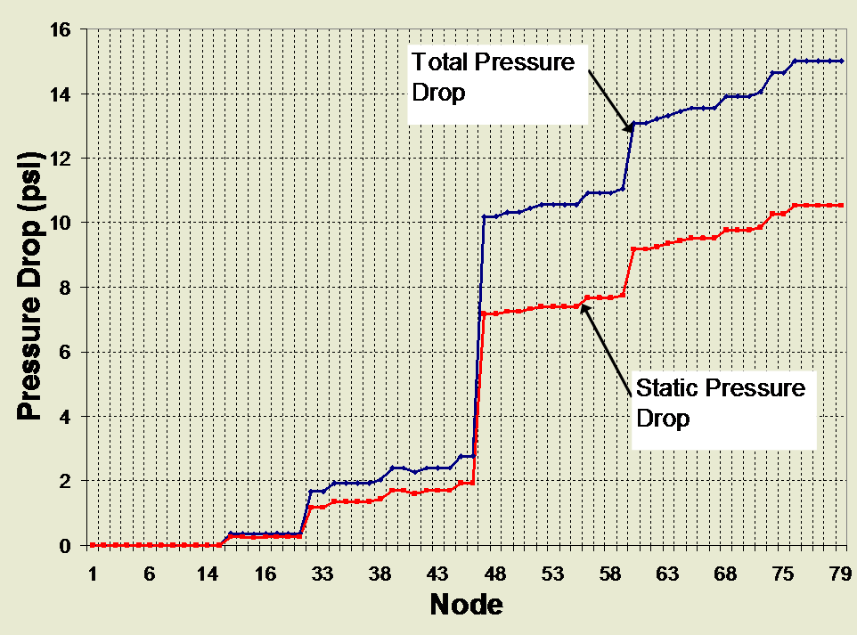
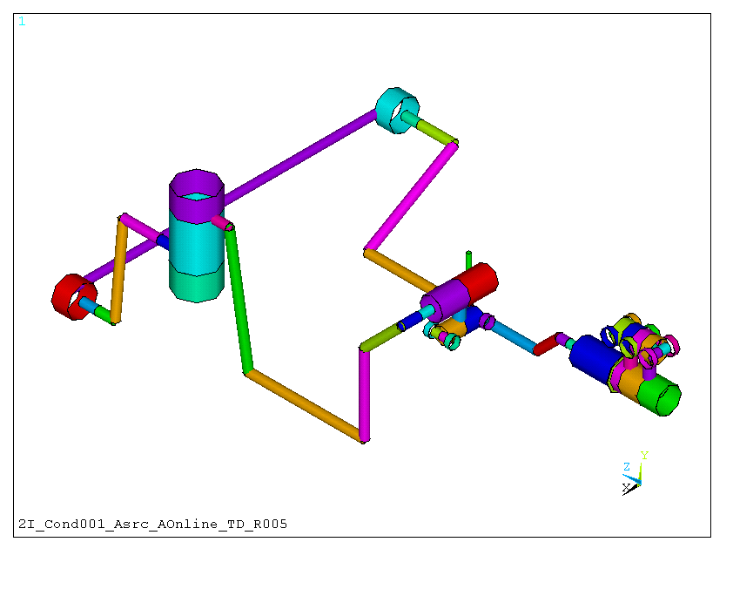
Static vs. Dynamic Pressure Drop
Dynamic
Pressure
Drop:
4-5 psi
Cooler Pressure Drop = 7 psi
KE

Slide 64
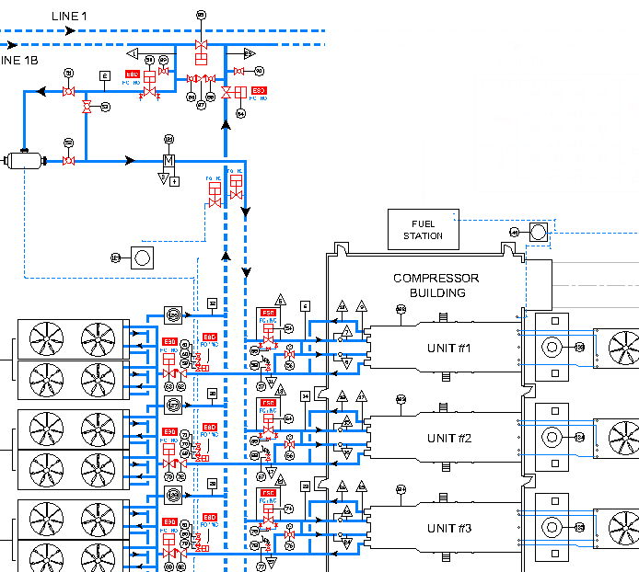

Quick Review: Pressure Drops
OEM Performance
Flange to Flange
System Performance
Fence to Fence
Used for initial sizing of compressor cylinders
System Performance includes total pressure drop through all elements:
Piping system
Scrubbers, vessels
Coolers
Compressor
Pulsation Control (bottles, orifices, etc.)
KE

Slide 65


Quick Review: Pressure Drops
Summary
Static and Total Pressure Drop Important for Pulsation Control Devices
System Pressure Drop Key to Understanding Performance
KE

Slide 66





Goals
VS
VS
Battle
Royale
Physics
VS
VS
Logistics
VS
VS
Costs
DH

Slide 67

Battle Royale: End-User
Goals:
  Flexible Unit
  Lots of Unloading Potential
  Safe to Unload Across entire Operating Map
  Smooth Load and Flow Changes
  Low Costs Solutions
  Minimal Pressure Drops
  Minimal Vibrations
  Dampened Pulsations
  Minimal Maintenance
DH

Slide 68

Battle Royale
Captain, I can't change the laws of physics.
We’re just engineers, not miracle workers.
DH

Slide 69

Battle Royale: Physics
Constraints:
  Rod Load & Pin Loading Limits
  Process Limits
  Crankshaft Limits
  Lubrication Limits
  Gas Velocity Limits
  Torsional Limits
  Pulsation and Vibration Limits
  Temperature Limits
  Pressure Limits
  Thermodynamic Limits
DH

Slide 70
Battle Royale: Logistics
Constraints:
  Size and Number of Frames Limited
  Size and Number of Cylinders Limited
  Number of Unloading Devices Limited
  Types of Unloading Devices Limited
  Shipping Size Restrictions
  Foundry Restrictions
  Inventory Limits
  Machining Limits
  Materials Limits
DH

Slide 71

Battle Royale: Costs
Costs (Related to Unloading):
  Too Many Devices → Higher Initial Costs
  Too Few Devices → Lost Revenues
  High Complexity → Higher Maintenance
  Higher Pressure Drops → Lower Revenues
  Longer Lead Times → Delayed Revenues
  Larger Skid/Building → Higher Initial Costs
  Bottle & Piping Changes → Higher Costs
DH

Slide 72

Battle Royale
Capital Costs
Low Cost Option
Performance
Reliability
Low Pressure Drop
Low Pulsations/Vibrations
KE

Slide 73
Battle Royale
Approach 1 - Small Bottles = Save Costs and Time
Tight Orifice Plates/Choke Tubes
  Leads to high pressure drop, more power, and lower flow rates
Back-off on orifices and choke tubes to minimize pressure drop
  Leads to increased pulsations, increased shaking forces, risk of fatigue failure from vibration
Capital Costs
Low Cost Option
Performance
Reliability
Low Pressure Drop
Low Puls/Vib
KE

Slide 74
Battle Royale
Approach 2 – Large Bottles to Control Pulsations
Large Bottles provide High Dynamic Flexibility
  But, may need large bottle supports, and/or special nozzle reinforcements
Limited access due to large bottles and supports
Bottle pressure drop is low
  What about the rest of the system? Future Pressures and Load Steps?
Capital Costs
Low Cost Option
Performance
Reliability
Low Pressure Drop
Low Puls/Vib
KE

Slide 75
Battle Royale
Approach 3 – System Design Approach
Balance pulsation control vs. pressure drop for full map of operating conditions
Cost is more than Approach 1, less than 2
Take more time to finalize design
Input from owner is key to successful project
  Some compromises will need to be made, for example limit part of operating map.
Capital Costs
Low Cost Option
Performance
Reliability
Low Pressure Drop
Low Puls/Vib
KE

Slide 76


Developing Good Load Steps
OK! So what’s the Procedure for
Developing Good Load Step
Sequences?
DH

Slide 77
Step 1: Develop Good Load Steps
Prevent Unit Overloading
Maximum Coverage of Desired Operating Map
Reduce/Prevent Possible Safety Concerns
Ideal Load and/or Flow Changes between Steps
Concentrate Unloading on First Stage Cylinders
Use Clearance Unloading as much as Possible
Balance Cylinder Loads
Balance Stage Loads
DH

Slide 78
Step 2: Check for Torsional Issues
Explore changing which throws are unloaded as possible remedies for torsional problems;
Look at potential of adding additional clearance instead of single acting cylinders.
Sometimes torsional soft couplings and/or added inertia may be required.
Stronger crank materials may also be needed.
JF

Slide 79
Step 3: Check for Acoustic Issues
Single Acting Operation requires Large Volumes
Double Acting Operation has much Lower Pulsation
Large Volumes need More Support and Space
Use Clearance Unloading as much as Possible.
  Use HE and CE if possible
Pulsation and Vibration may be Speed Sensitive
  Some Speed Ranges may need to be Blocked
Trade-off: Capital $’s vs. Long Term Operating $’s
KE

Slide 80
Step 4: Review Final Load Steps
Torsional Concerns Resolved
Rod Load/Pin Reversal Concerns Resolved
Vibration Concerns Resolved
Pulsations Minimized
Pressure Drops Minimized
Load/Flow Step Changes Acceptable
Amount of Turn Down Acceptable
Desired Operating Map Fully Covered
  If not, what are alternate options?
Project Manager to ensure all factors are balanced, and end-user gets what they need.
KE

Slide 81
Case I: New Unit:
JF

Slide 82
Case I: New Unit:
Consider a Single Stage Pipeline Compressor:
One of the operating cases requires that two of the cylinders be single-acted to be within driver’s maximum rated power.
Two choices are available for unloading:
    Side-by-side Throws
    Opposing Throws
JF

Slide 83

  Summary of Conditions showing Power, Flow and Generated Torques:
JF

Slide 84
  Unloading Effects on Torque Demand Curves
  All Double-Acting
  Side-by-Side
  Unloaded
  Opposing
  Unloaded
JF

Slide 85
Case II: Expanded Op. Map:
KE

Slide 86
Case II: Expanded Op. Map:
Gas Storage Facility
3 High Speed Compressor Packages
1 and 2 stage operation
Original Design in 2008
2 stage
  Ps=500 to 700 psig
  Pd=1770 to 3300 psig
5 Load Steps
  1st stage FVCP and HE Unloaders
KE

Slide 87


Original Design
Pulsation Design
Large Bottles with Internals
0.6 Beta Ratio Orifice Plates in the Cylinder Flanges
Pressure Drop within API 618
Robust and Efficient Design for a Complex Application
KE

Slide 88



Original Operating Map
Design Guideline
KE

Slide 89


Original Operating Map
KE

Slide 90


Expanded Operating Map
Suction Pressure
Load Steps
DBL
DBL
KE

Slide 91


Expanded Operating Map
Shaking Force is 3.5x Guideline
Shaking Force is Too High for Many Pressures and Load Steps
Risk of Vibration and Fatigue Failure
KE

Slide 92

Expanded Operating Map
KE

Slide 93
Expanded Operating Map
Load Step 0-2 not okay to run without redesign
Load Step 3-9 okay to run
KE

Slide 94
Case II: Expanded Op. Map:
Summary:
Increase in suction pressure and single acting all 1st stage cylinders results in high risk of vibration
New pulsation bottle design required for suction and discharge OR
Conduct Mechanical Analysis to see if vibration and dynamic stress will be OK
Check wider range of conditions in the original design
KE

Slide 95
Case III: Unit Reapplication:
KE

Slide 96


Case III: Unit Reapplication:
Existing Compressor
4 Throw, Single Stage, Double-Acting
New Application
Suction pressure declining, Two-Stage Required
150 psig to 350 psig, Single-Acting 1st Stage
KE

Slide 97
Case III: Unit Reapplication:
Changes made to
Pipe
Cooler
Bottles
Cylinders
KE

Slide 98


Case III: Unit Reapplication:
Pulsation Design:
Pipe Expansion
Orifice Plates
Slightly Larger
Bottles
Some Bottle
Internals Req’d
KE

Slide 99

Case III: Unit Reapplication:
Pulsation Design was Acceptable
(Including 1st Stage Single-Acting)
DH

Slide 100


Case III: Unit Reapplication:
Summer 2012
Broken Anchor Bolt
In Pipe Support Base
Failed Weld in
Cooler Enclosure
What’s Going On?
KE

Slide 101
Case III: Unit Reapplication:
Reapplication in 2009
Suction pressure 150 psig to 350 psig
Single-Acting 1st Stage
Re-Reapplication in 2012
Suction pressure 150 psig to 450 psig
Single-Acting 1st Stage plus
  One Single-Acting 2nd Stage Cylinder, and
  Added CE Spacers on all Throws
KE

Slide 102

Case III: Unit Reapplication:
Interstage Pulsation Model
Cooler Enclosure Failure
Suction Pipe Force
Cooler Force
Broken Anchor Bolt
In Pipe Support Base
KE

Slide 103


Case III: Unit Reapplication:
Suction Pipe Force
KE

Slide 104


Case III: Unit Reapplication:
Cooler Force
KE

Slide 105

Case III: Unit Reapplication:
Replace 3.5-in ID Orifice
with 2.0-in ID Orifice
KE

Slide 106


Case III: Unit Reapplication:
Cooler Force
Suction Pipe Force
Forces Reduced to Guideline ….
BUT….
2.0-in ID Orifice in a 6-in XS Line
KE

Slide 107

Case III: Unit Reapplication:
Pressure Drop up to 8x API 618 Guideline
Is this a Problem?
KE

Slide 108

Case III: Unit Reapplication:
Required Power < Available Power
Change in Flow Rate < 2%
OK!!!
KE

Slide 109
Case III: Unit Reapplication:
Summary:
Reapplication from 1-stage to 2-stage with 1st Stage SA Load Steps
  Slightly Larger Bottles with Internals
Subsequent change to 2nd Stage Load Steps
  High Shaking Forces Lead to Failure
  Simple Change in Orifice Plates Caused High Pressure Drop and Power Loss but Reduced Forces
Lessons Learned:
  Evaluate Future Operation
  Trade-off of Efficiency vs. Reliability
KE

Slide 110
Conclusions:
Load Steps have a Major Impact on Efficiency and Reliability
Equally Balance Cylinder Loading when Possible
Carefully Consider where Unit will Operate Today, Tomorrow and in the Future
Early Communication (FEED Stage) between OEM, End-User, and Consultants is Key
Set Targets/Design Goal that Realize Limitations and Trade-offs
ALL

Slide 111

End-Users
Consultants
Pulsations
Vibrations
OEMs
Torsionals

Slide 112


Questions

